Slide 1



Recent CMS results in top and Higgs physics
Rebeca Gonzalez Suarez
University of Nebraska, Lincoln

Slide 2


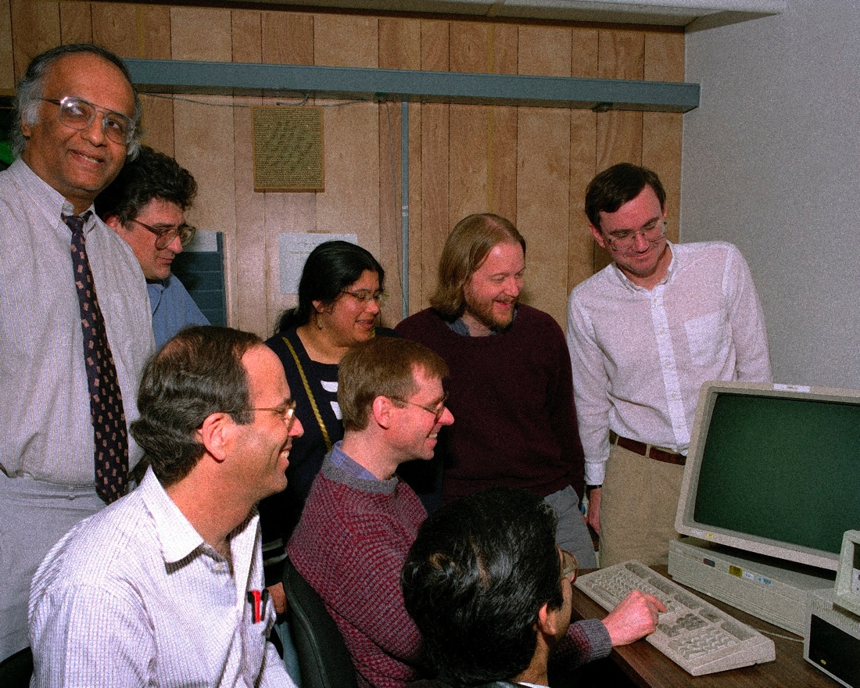
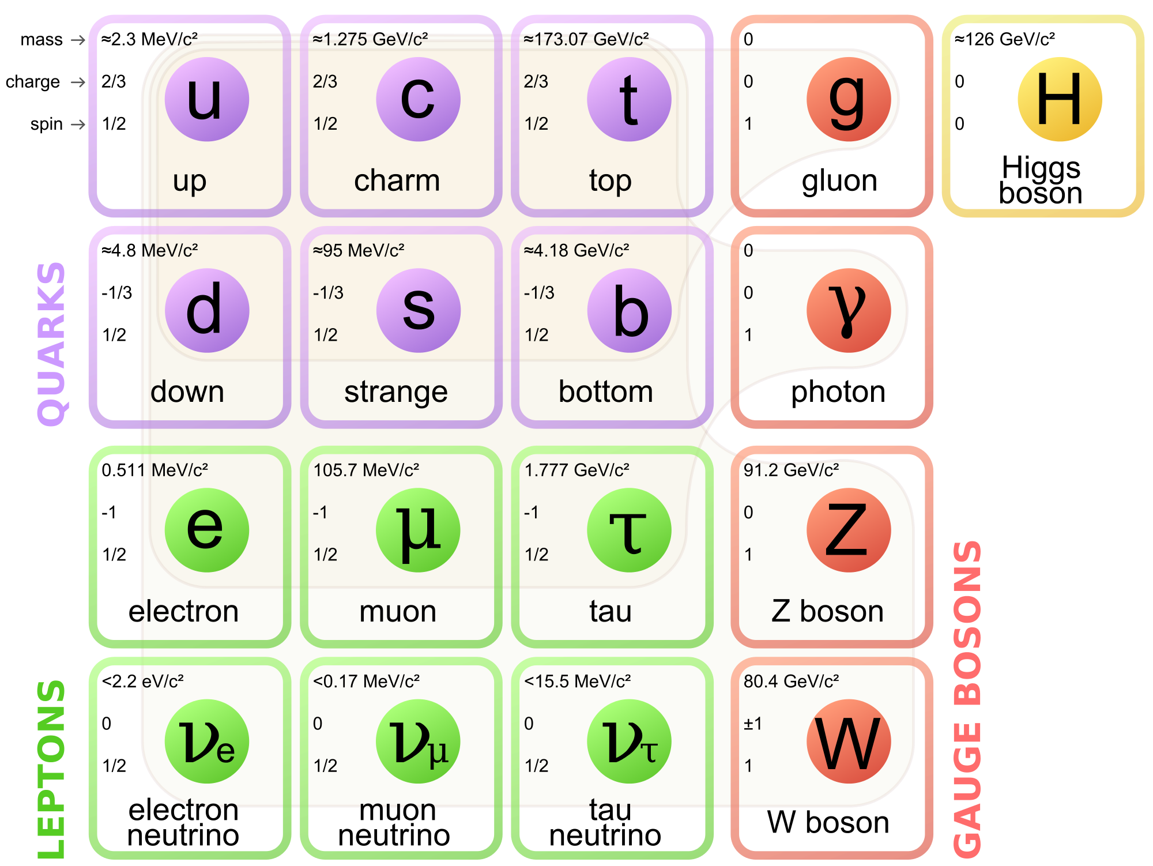
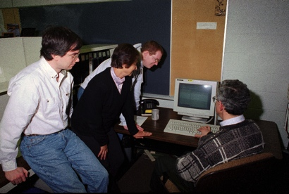
February 24, 1995
CDF and DZero, submitted the Top Discovery papers to PRL:
[PRL 74, 2626–2631, PRL 74, 2632–2637]
The quark family picture was completed, and it happened here, 20 years ago
https://indico.fnal.gov/conferenceDisplay.py?confId=8961
I was 13 years old…

Slide 3


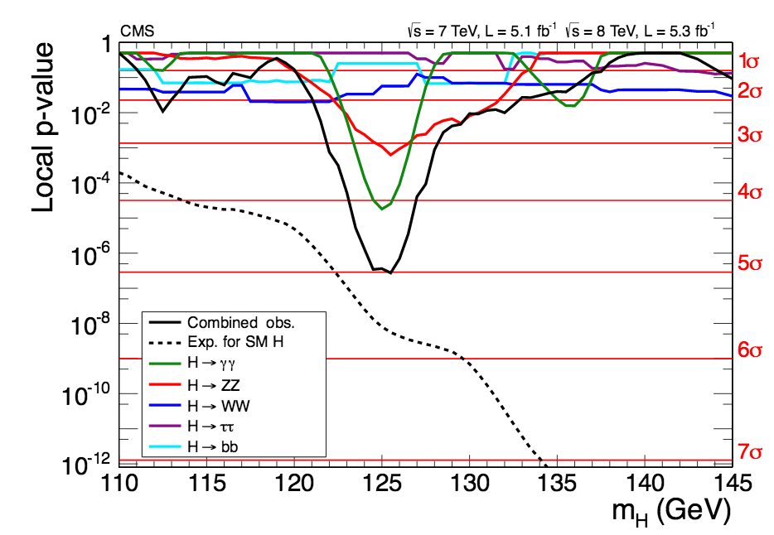
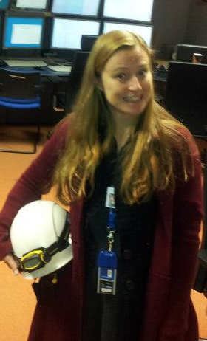
July 4, 2012
CERN reported the discovery of the Higgs boson at the LHC:
http://press.web.cern.ch/press-releases/2012/07/cern-experiments-observe-particle-consistent-long-sought-higgs-boson → papers by ATLAS and CMS [arXiv:1207.7235] followed
The Higgs boson was finally found after 60 years of searches
And I was 30…

Slide 4
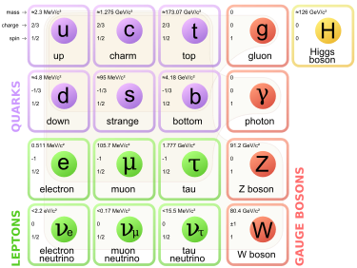
The (in)complete SM picture
The first scalar particle was observed, candidate to confirm the Higgs mechanism of mass generation via spontaneous EW symmetry breaking
But the first run of the LHC found no other hint of new phenomena, and there are experimental facts that the SM cannot explain (yet)
i.e.: Neutrino masses, the CP problem, dark matter and energy, baryon asymmetry in the Universe…
Both the top quark and the Higgs boson, independently, could be the gateway to new physics at the LHC → maybe also together

Slide 5
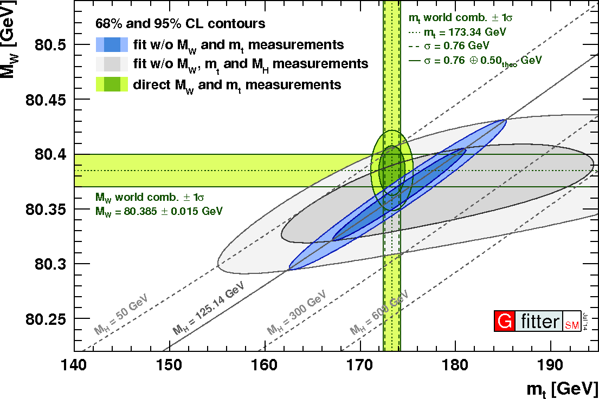
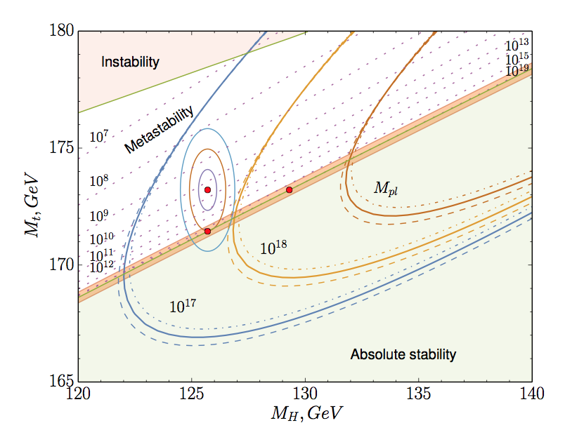
Top and Higgs
Top and Higgs are deeply related
The measurement of the top quark mass, together with the W boson mass places constraints on the mass of the Standard Model Higgs boson
A precise measurement of the mass of the Higgs and the mass of the top allows conclusions regarding the fate of the Universe via the analysis of the vacuum stability
The coupling of the Higgs to top quarks is very strong in the SM and suggest a special role in the electroweak breaking mechanism and in its possible extensions
gfitter
Phys. Rev. Lett. 115 (2015) 201802
arXiv:1507.08833

Slide 6
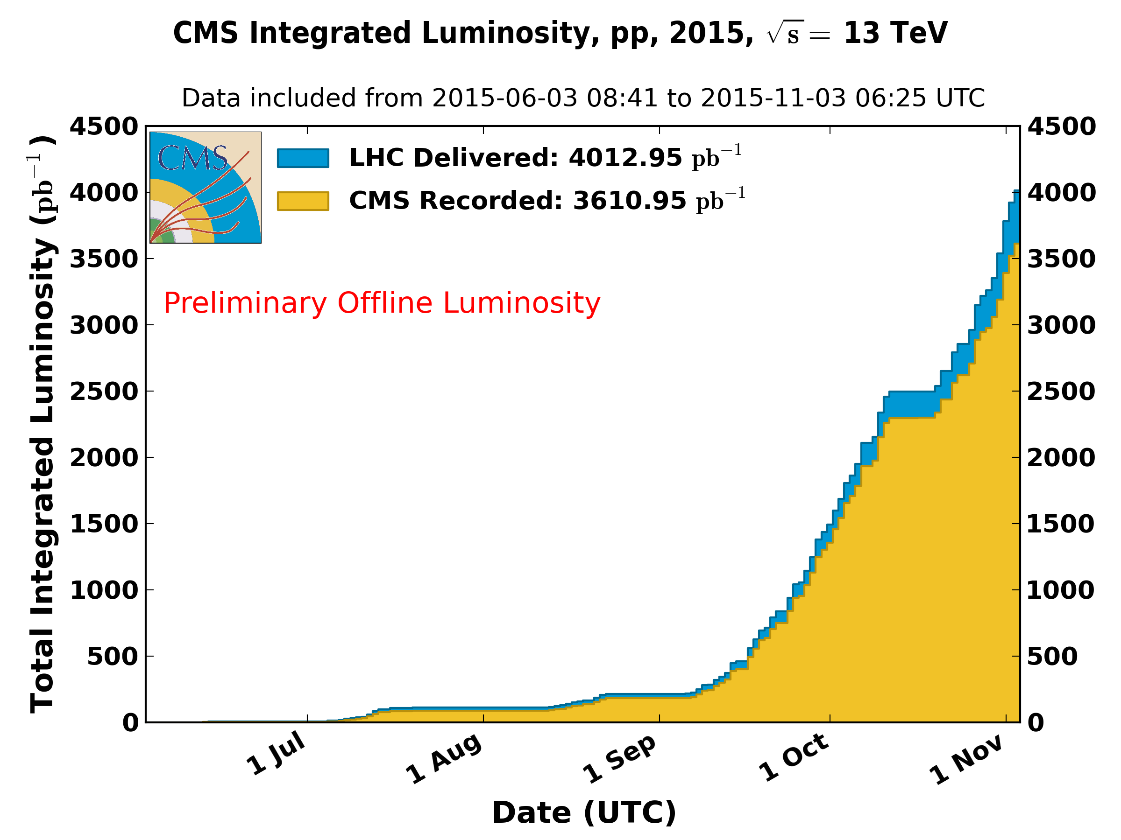
Current status of the LHC
We have entered a new energy regime
The LHC started running again this year
→ the 2015 pp run at 13TeV ended Nov. 4th
Though the full potential of Run-2 is still ahead of us
the LHC already delivered 4fb⁻¹ of integrated luminosity
The Run-1 dataset is still being analyzed
5.1 fb⁻¹ at 7 TeV and up to 19.7 fb⁻¹ at 8 TeV
Higgs: Not only observation, also the first characterization of its properties
The first Run-2 results are arriving
Top results already did! → stay tuned for Moriond 2016

Slide 7
Higgs physics at the LHC today
The Run-1 legacy

Slide 8
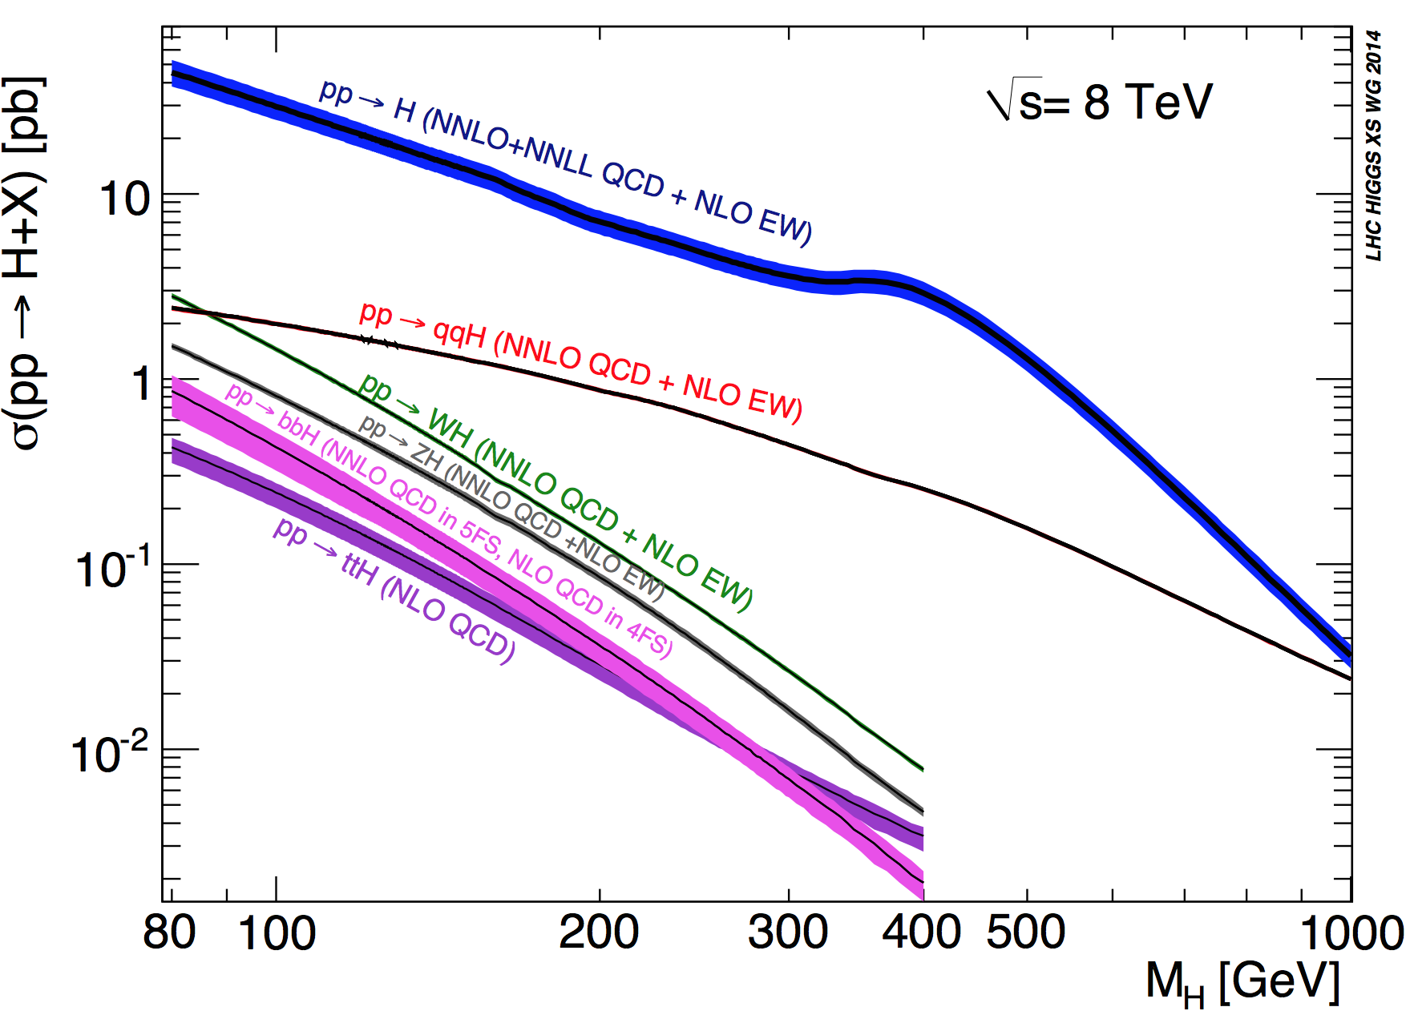
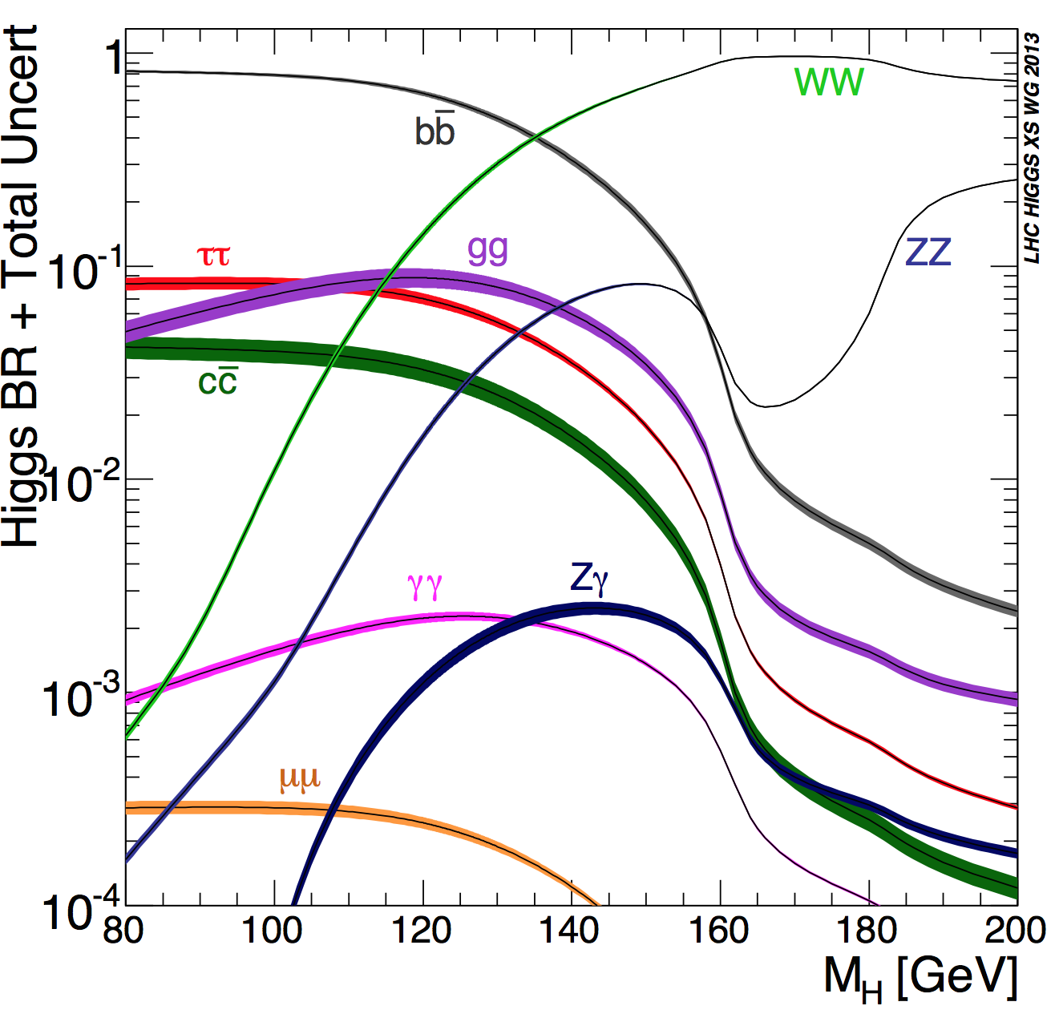
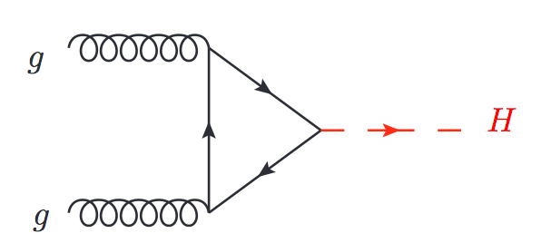
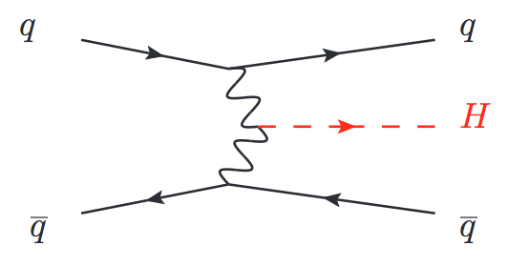
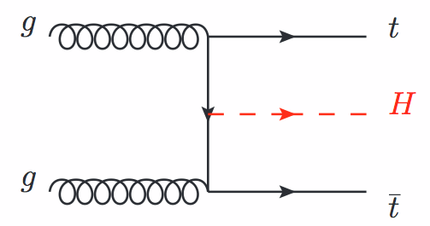
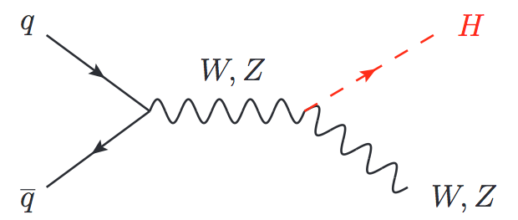
The Higgs searches
The start of the Run-1 found us looking for the Higgs everywhere → we performed a full mass scan from the LEP limit of 114.4 until above 600GeV
And we found it → We observed it with different levels of confidence, in a variety of decay channels, exploiting all possible production modes

Slide 9
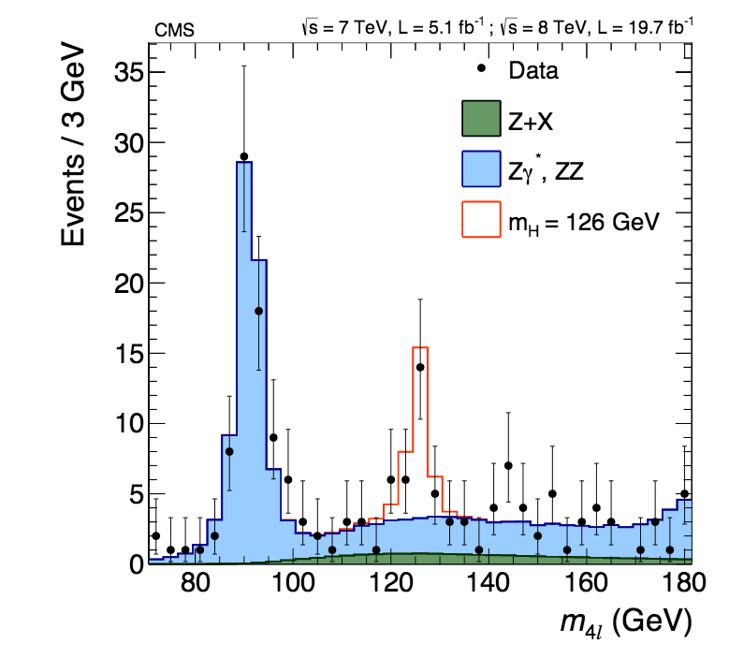
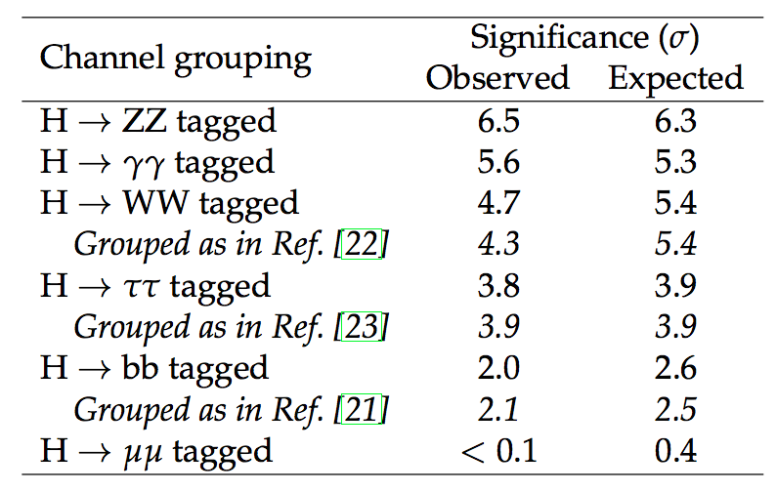
Main Channels
Phys. Rev. D 89 (2014) 092007
arXiv:1312.5353
Eur. Phys. J. C 75 (2015) 212
arXiv:1412.8662
Observed and median expected significances of the excesses for each decay mode
H → ZZ → 4l
Clear four-lepton mass peak over a small continuum background

Slide 10
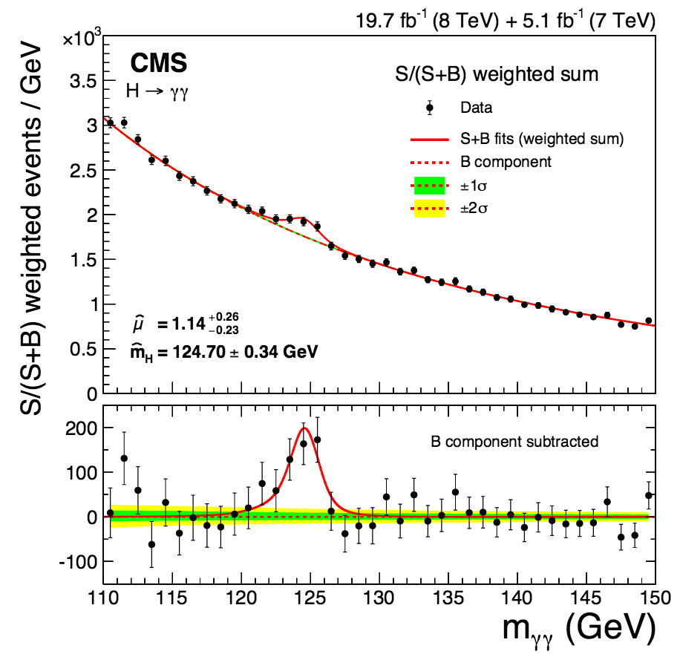
Main Channels
Eur. Phys. J. C 74 (2014) 3076
arXiv:1407.0558
Eur. Phys. J. C 75 (2015) 212
arXiv:1412.8662
Observed and median expected significances of the excesses for each decay mode
H → γγ
mass peak on a smooth background

Slide 11
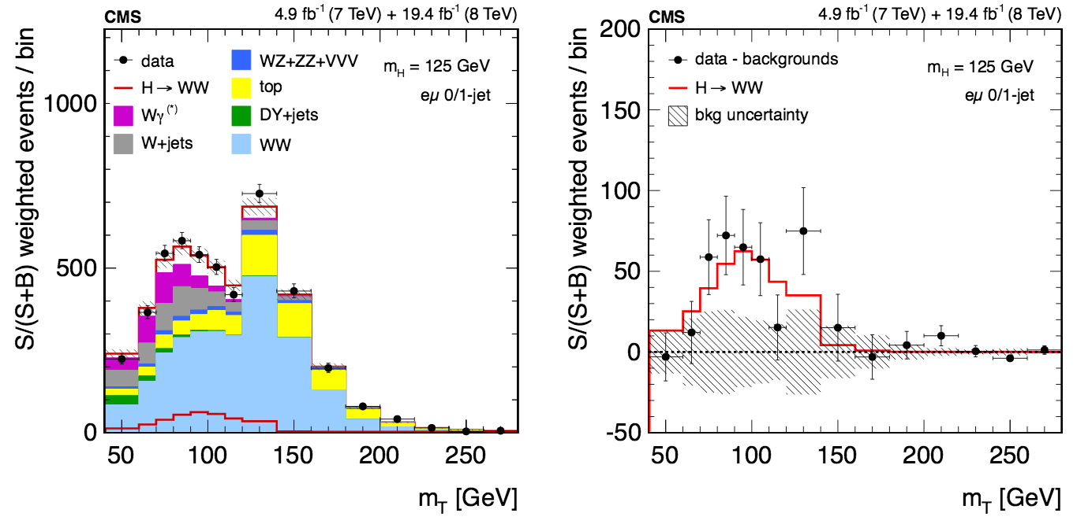
Main Channels
Eur. Phys. J. C 75 (2015) 212
arXiv:1412.8662
JHEP 01 (2014) 096
arXiv:1312.1129
Observed and median expected significances of the excesses for each decay mode
H→WW
No mass peak but clear signature (opposite sign leptons, Etmiss) second branching ratio at 125GeV

Slide 12
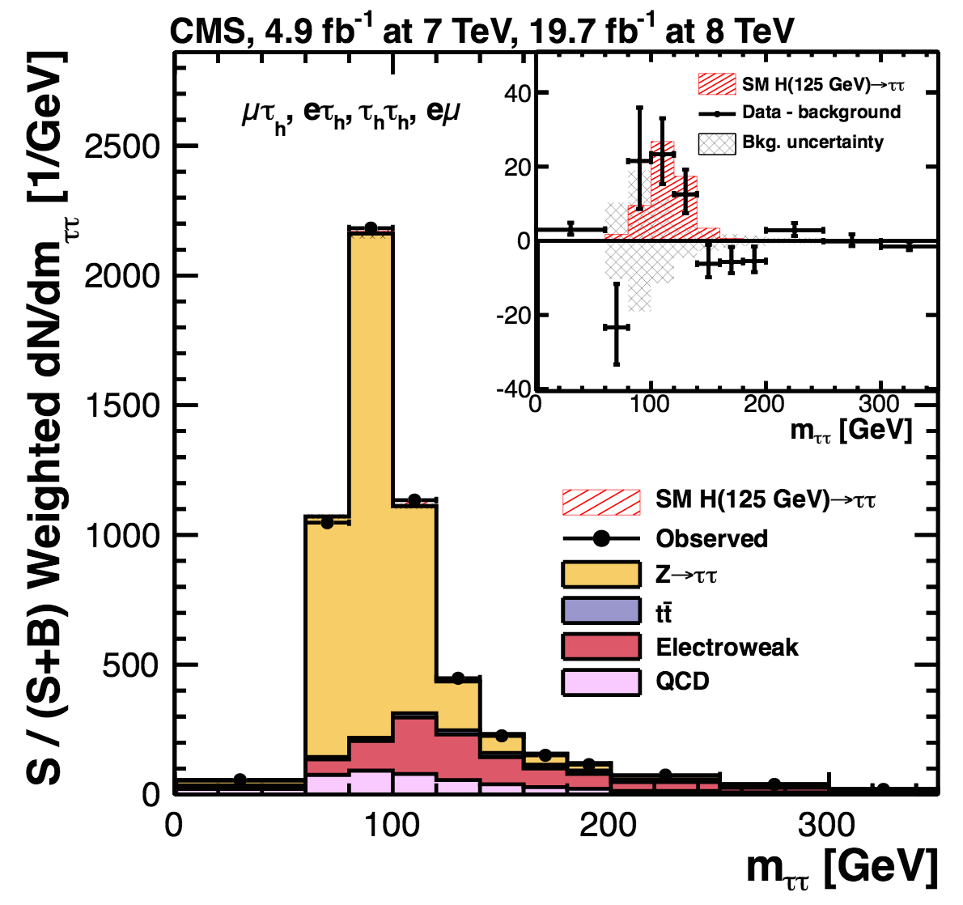
Main Channels
JHEP 05 (2014) 104
arXiv:1401.5041
Eur. Phys. J. C 75 (2015) 212
arXiv:1412.8662
Observed and median expected significances of the excesses for each decay mode
H → ττ
excess of events over SM background using multiple final-state signatures

Slide 13
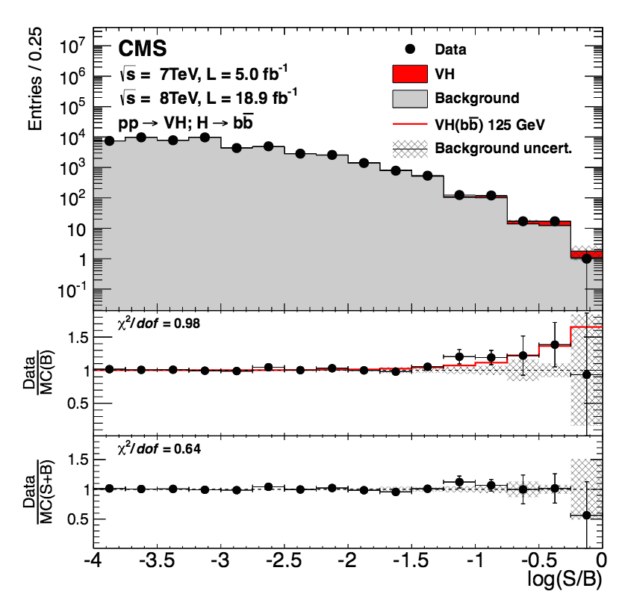
Main Channels
Eur. Phys. J. C 75 (2015) 212
arXiv:1412.8662
Phys. Rev. D 89, 012003 (2014)
arXiv:1310.3687
Observed and median expected significances of the excesses for each decay mode
H → bb
Highest branching fraction, VH production

Slide 14



Higgs properties
There is clearly a new particle, that is produced and decays much like a SM Higgs would
Next step after the searches → Precisely measure its properties
Charge, Couplings, Spin, Parity, Mass, Width…
Properties are handles to find deviations with respect to the SM expectations, corners where new physics may be hiding:
How much can be done already with Run-1 data?
Reality?
SM prediction
Reality?

Slide 15
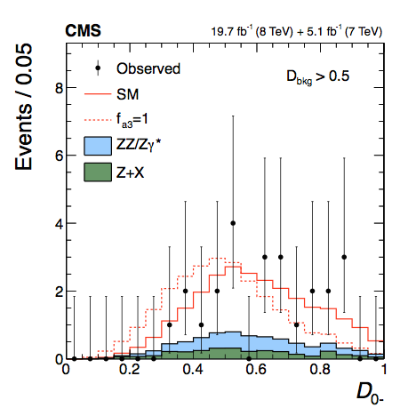
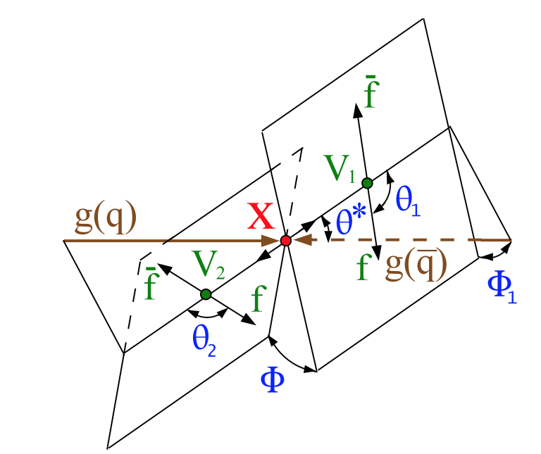
Spin and tensor structure
H→VV decays (V=Z,W,γ)
The analysis is done via the study of the kinematic distributions of the decay products that are determined by the tensor structure of the HVV interactions
The number of kinematic variables available determines the strategy followed in each channel, and depends on the Higgs decay
H→WW limited sensitivity due to undetected neutrinos in the dilepton final state
H→ZZ→4l, complete final state can be reconstructed → Full kinematic information accessible
The information is condensed in a set of discriminants
Phys. Rev. D 92, 012004 (2015)
arXiv:1411.3441

Slide 16
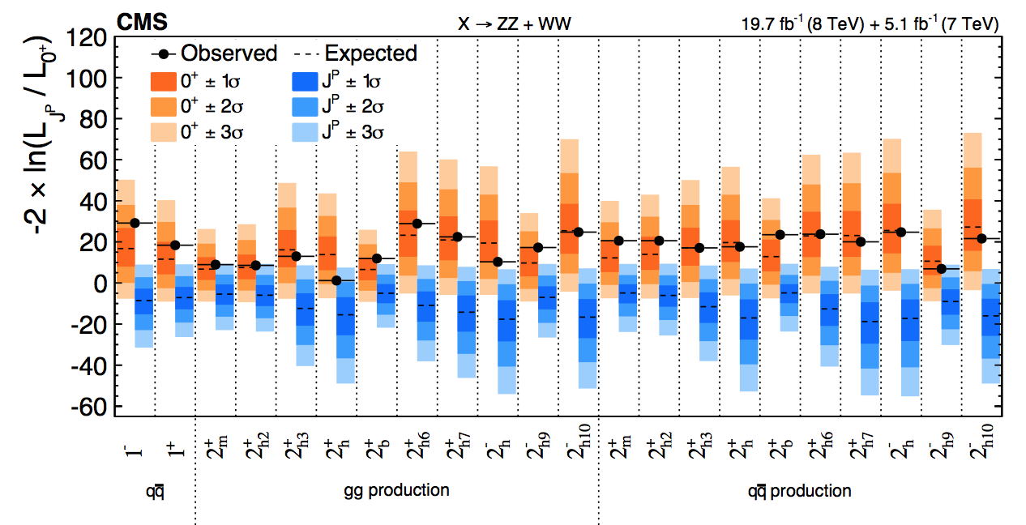
Exotic spin
We tested different BSM spin and CP hypotheses in HWW and HZZ
→ Exotic spin-1 or spin-2, BSM 0⁻ 0⁺_{h}
All spin-1 hypotheses excluded at > 99.999% CL , Spin-2 boson 2⁺_{m}, excluded at a 99.87% CL, other spin-2 hypotheses excluded at a ≥99% CL
→ Spin 0 particle favored

Slide 17
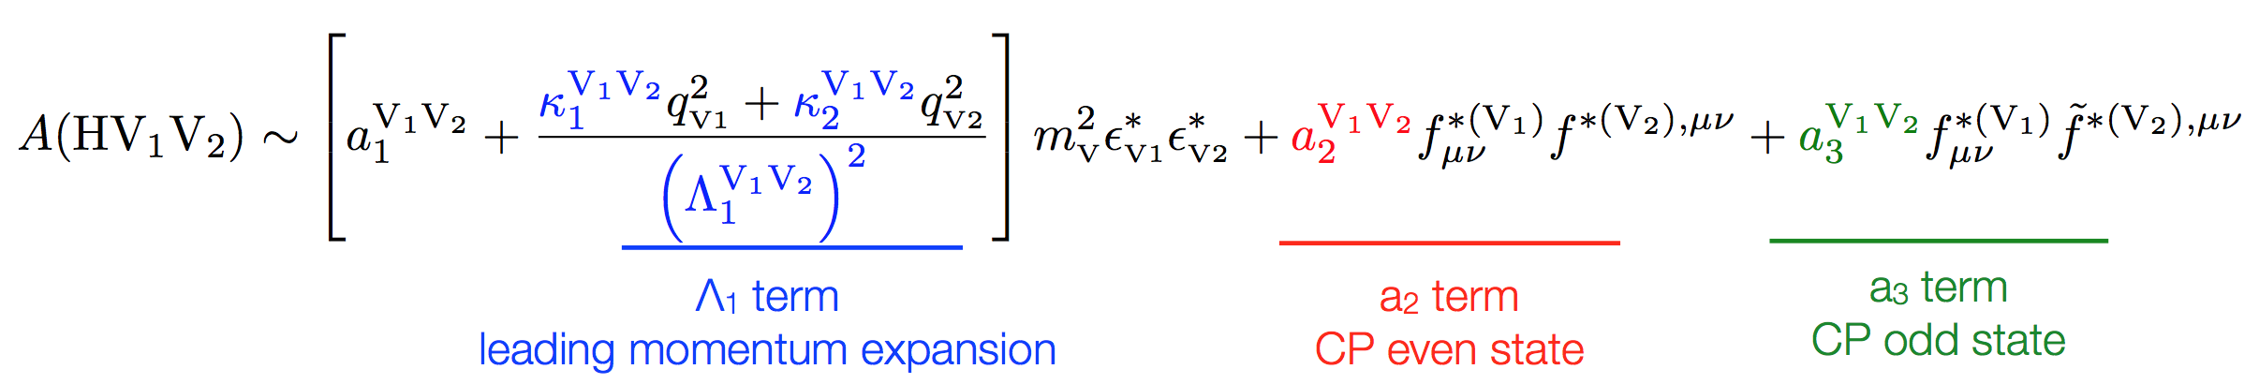
Spin-0: CMS
Once the exotic spin hypothesis is ruled out → study of the tensor structure of the HVV interactions setting limits on anomalous couplings under spin-0 assumption
The decay amplitude for a spin-0 boson to a pair of V bosons can be described as:
We choose a parameterization that relates the anomalous couplings coefficients: a₂, a₃, and Λ₁ to cross sections fractions (f_{a2}, f_{a3}, f_{Λ1})
The analysis is based on likelihood scans for the three effective fractions
Full set of scans available in ZZ and WW decays → all consistent with the SM

Slide 18
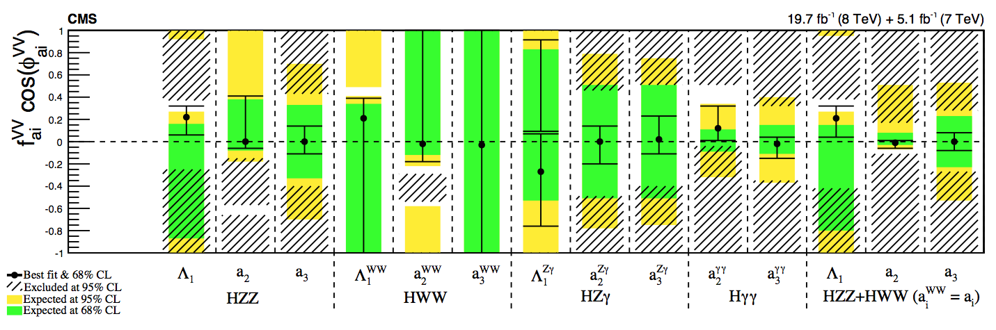
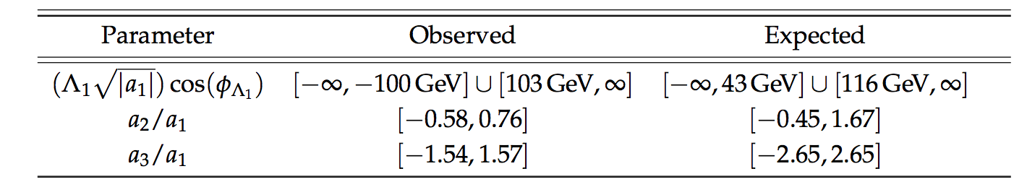
Summary of anomalous couplings
Allowed confidence level intervals for anomalous coupling parameters assuming real coupling ratios (π or 0)
Assuming custodial symmetry: pure 0_{h}⁺ (related to f_{a2}) excluded at 99.93% CL and pure 0⁻ (pseudoscalar, related to f_{a3}) excluded at 99.99% CL

Slide 19
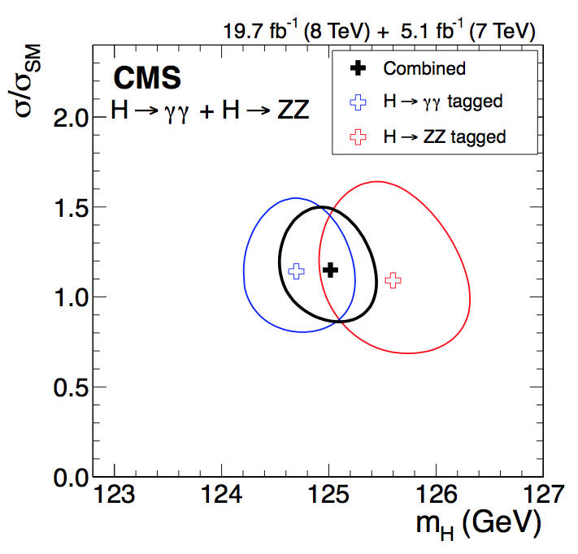
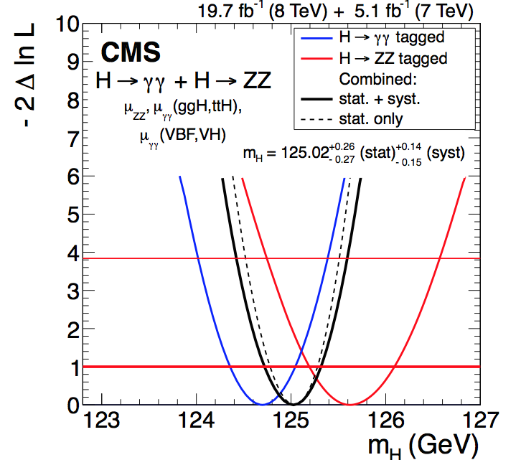
Mass measurement
CMS performed a combined Higgs measurement using information from all the channels studied during Run-1
In the high-resolution γγ and ZZ channels, the mass of the Higgs boson is determined to be:
m_{H} = 125.02 +0.26 (stat) +0.14 (syst) GeV
Eur. Phys. J. C 75 (2015) 212
arXiv:1412.8662

Slide 20
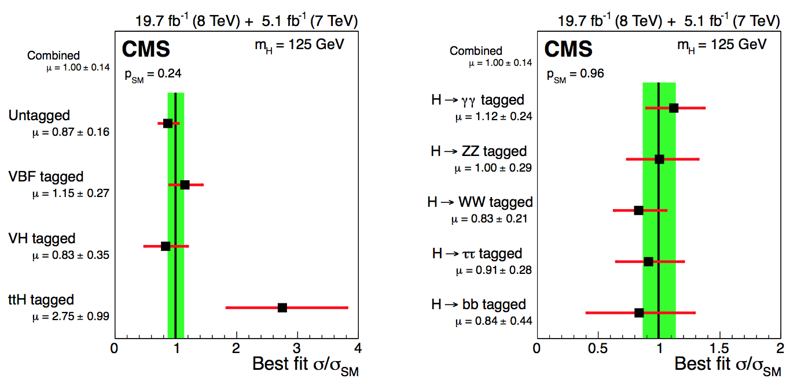
Compatibility with SM σ
The combined best-fit signal relative to the standard model expectation at the measured mass is:
1.00 ± 0.09 (stat) +0.08 (theo) ± 0.07 (syst)

Slide 21
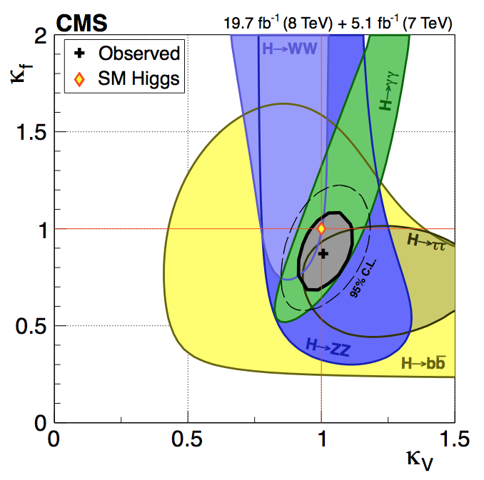
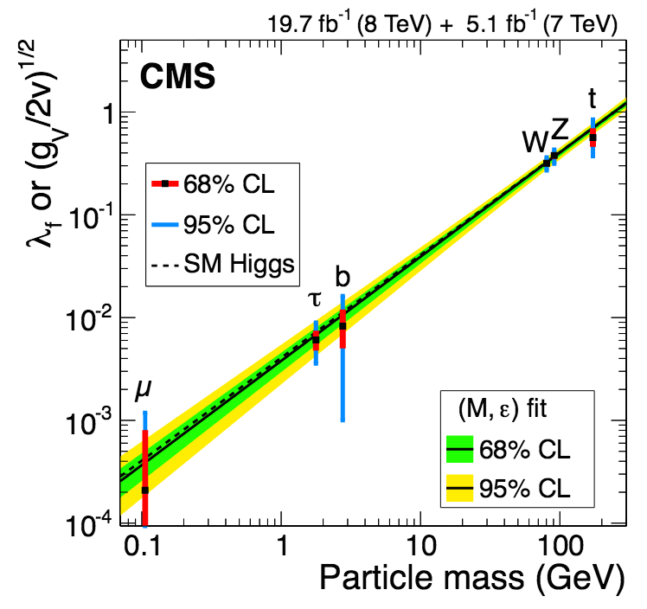
Couplings deviations
The couplings to massive vector bosons and fermions are also explored
Within uncertainties, everything is consistent with a SM Higgs

Slide 22
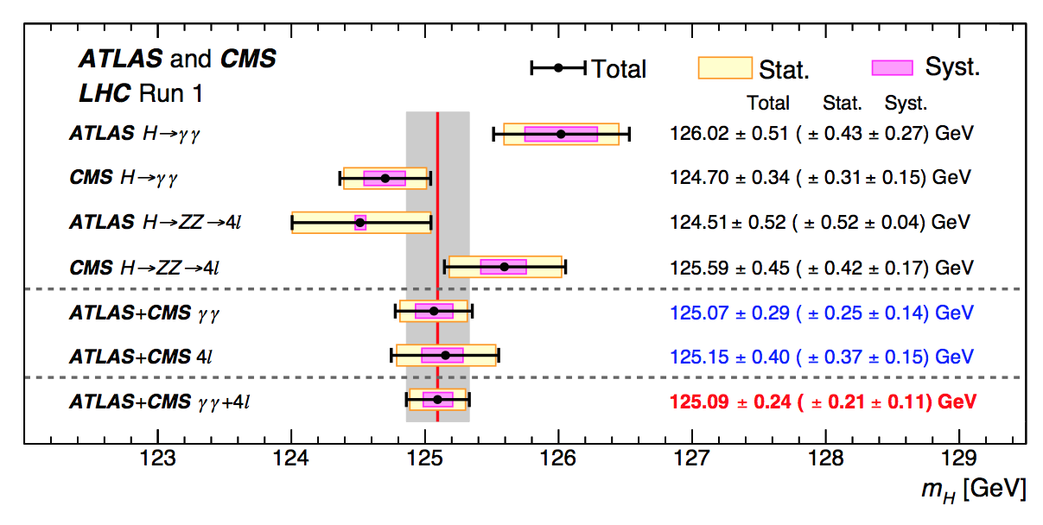
LHC mass combination
Combination of the Run 1 data from the two experiments, leading to improved precision for m_{H} (0.2%)
m_{H}=125.09±0.24 GeV=125.09±0.21(stat.) ±0.11(syst.)GeV
The uncertainty is dominated by the statistical term, systematic uncertainty dominated by the energy/momentum scales/resolution of γ, e, and µ
Phys. Rev. Lett. 114, 191803 (2015)
arXiv:1503.07589

Slide 23
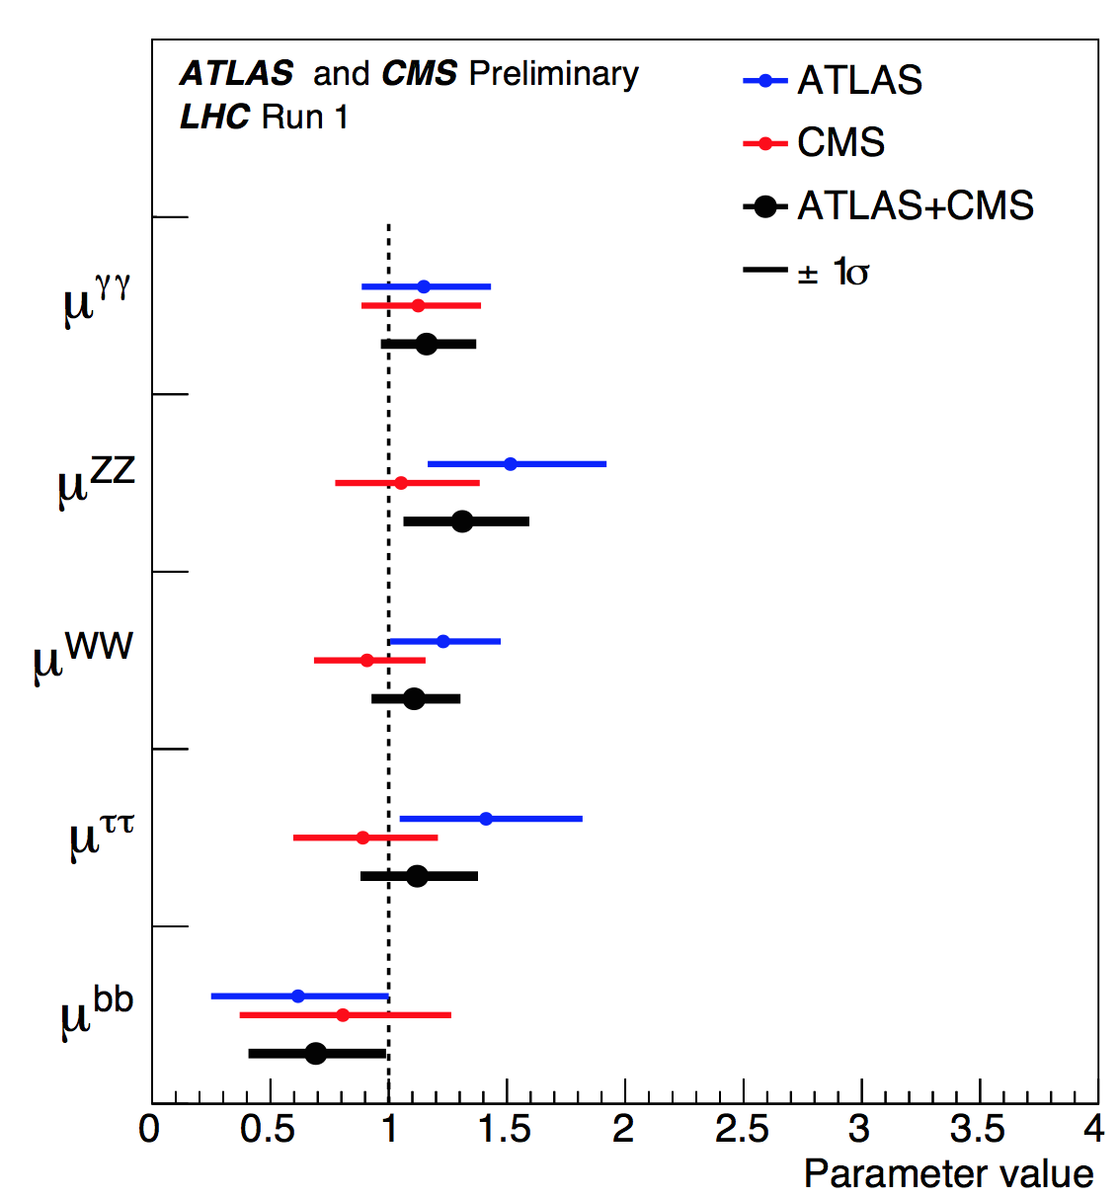
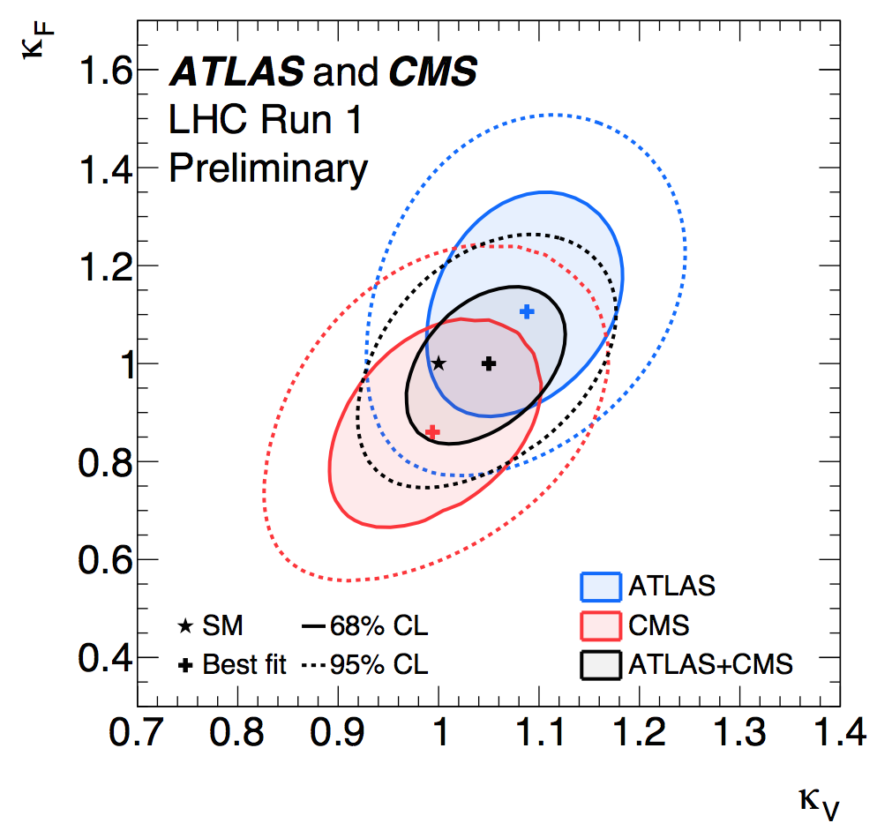
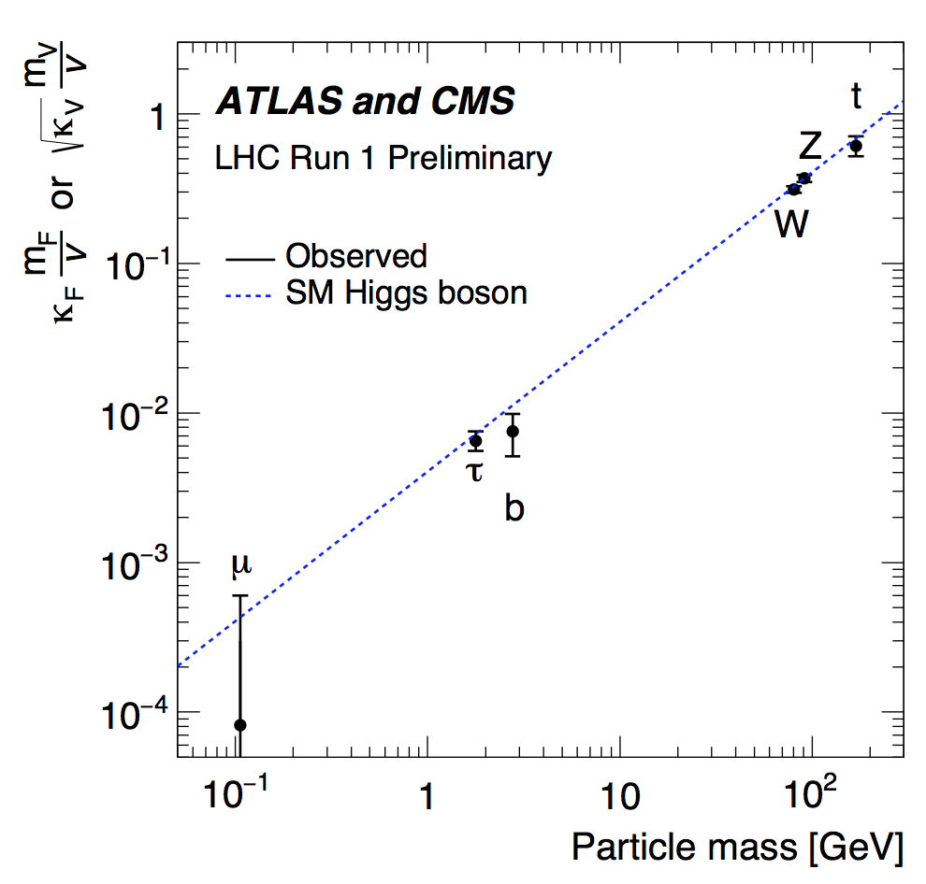
LHC combination
CMS-PAS-HIG-15-002
The combined signal yield relative to the SM expectation is measured to be 1.09±0.11
It achieved observation of H → ττ and VBF production, not possible by the experiments on their own
Weak neutral resonance, with quantum numbers J^{CP} = 0⁺⁺, coupling strengths compatible with the SM Higgs boson, and a mass of 125.09, well within the allowed SM Higgs mass in the EWK fits

Slide 24
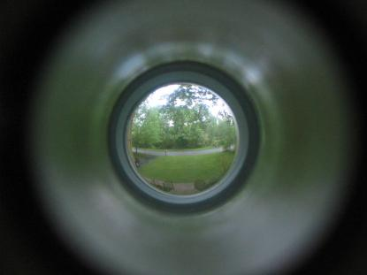
Looks like the SM Higgs from here
Looks like it is from here

Slide 25
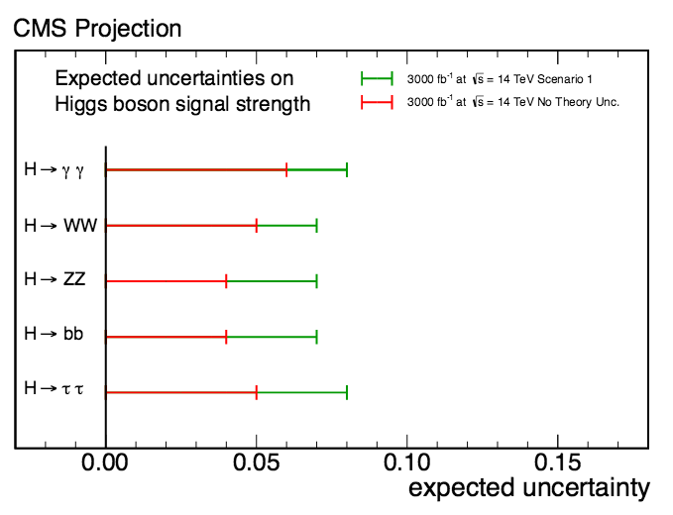
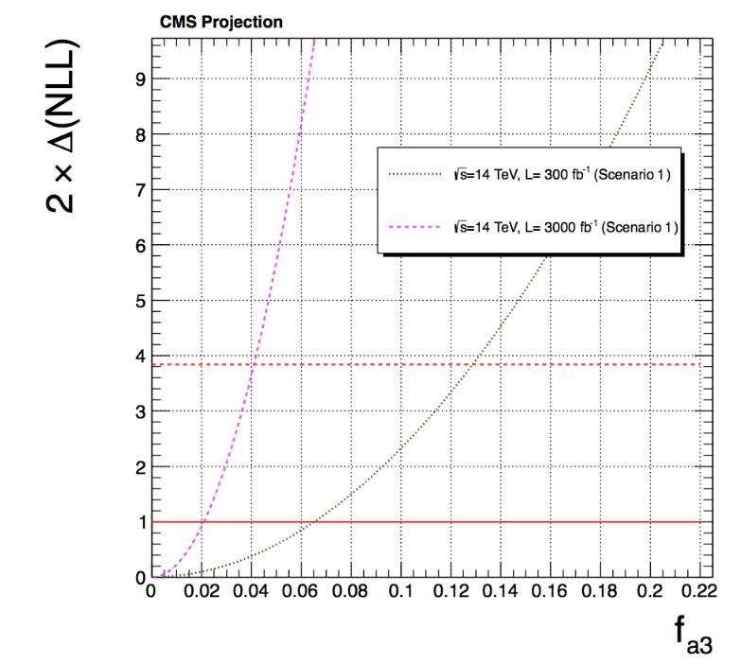
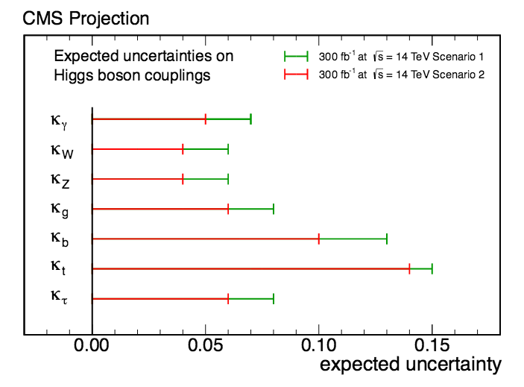

But only more data will tell
Projections at 14TeV-300/3000 fb⁻¹
From Snowmass
arXiv:1307.7135

Slide 26
Top physics at the LHC today
Early analyses at 13TeV

Slide 27
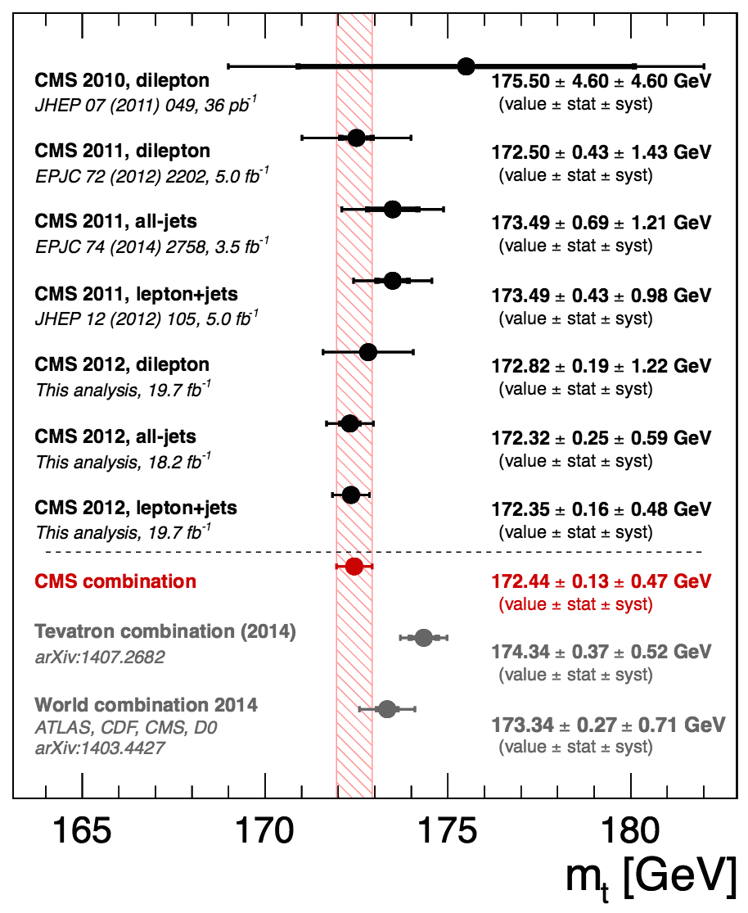
The top quark
The Tevatron legacy, together with a certified top factory → we are getting to know the top quark really well
Already in the high precision regime:
m_{top} =172.44±0.13 (stat)±0.47 (syst) GeV
prompts for a better understanding on how to link our simulation to fixed order calculation of m_{top}
The heaviest elementary particle known
Short lived → only quark that decays before hadronizing
direct access to properties
Good candidate to play a role in many scenarios of physics beyond the SM
Submitted to Phys. Rev. D
arXiv:1509.04044

Slide 28
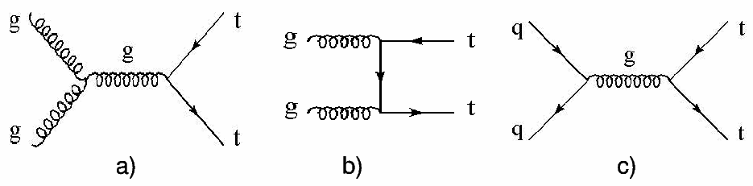
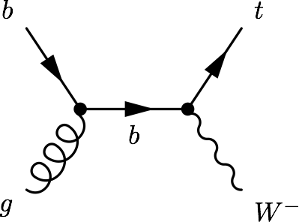
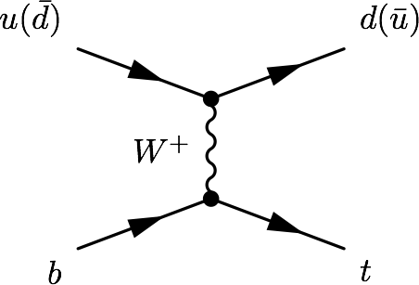
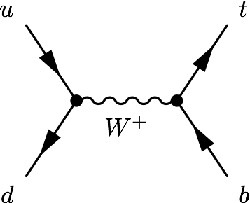
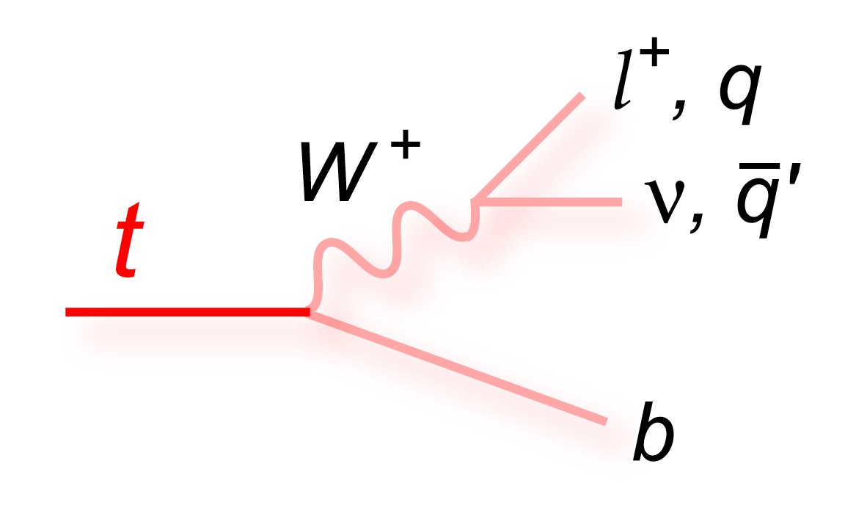
Production and decay
At the LHC, top quarks are produced mainly in ttbar pairs → strong interaction
Alternative mode, at a lower rate: Single top quark production→ EWK interaction
σ [pb] | ttbar | t-channel | tW | s-channel
Tevatron (1.96TeV) | 7.08 | 2.08 | 0.22 | 1.046
LHC @ 7TeV | 177.31 | 63.89 | 15.74 | 4.29
LHC @ 8TeV | 252.89 | 84.69 | 22.2 | 5.24
LHC @ 13TeV | 831.76 | 216.99 | 71.2 | 10.32
Top quarks decay almost exclusively as t→Wb
W → lnu (~32%), qq (~67%)

Slide 29
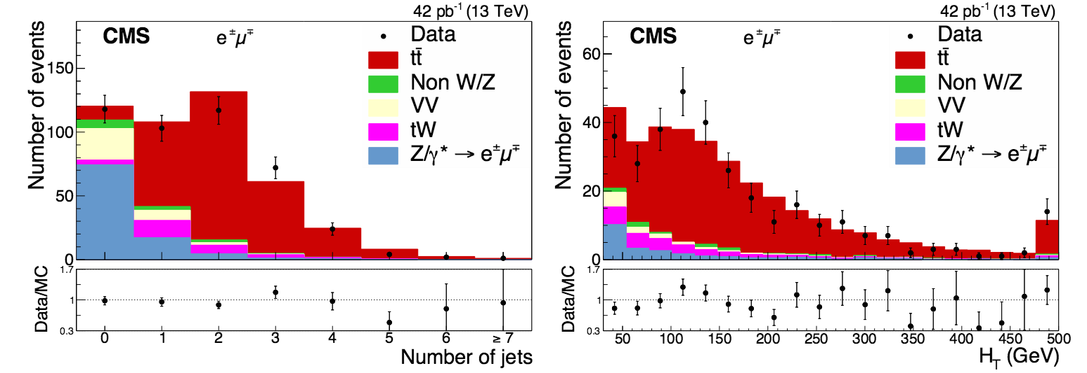
Dilepton cross section at 13TeV
Already with the very early data of Run-2 we measured the top pair production cross section
eµ final state, 42pb⁻¹, no b-tagging
Main systematics: trigger, lepton identification and isolation efficiencies (<5%)
σ_{tt}= 769±60 (stat)±55 (syst)±92 (lumi) pb
Submitted to Phys. Rev. Lett
arXiv:1510.05302

Slide 30
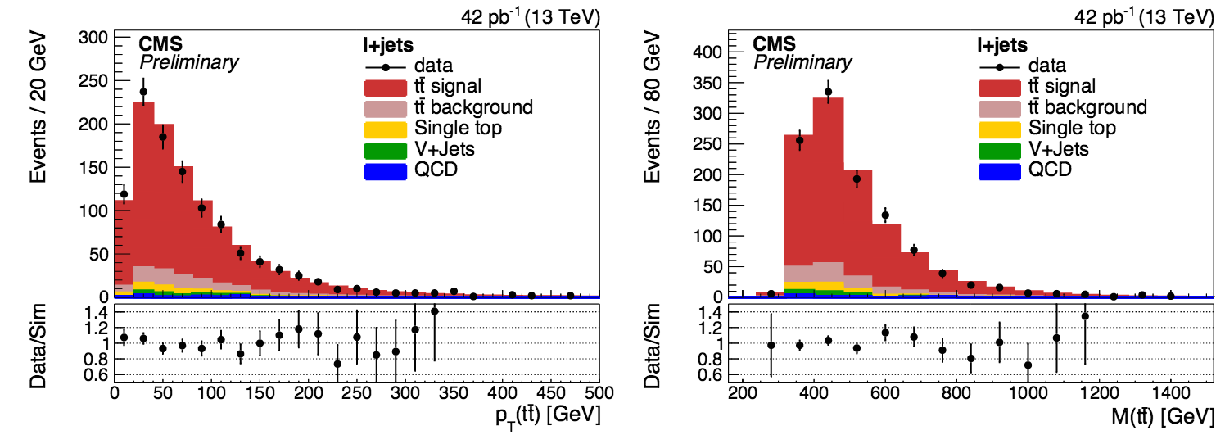
l+jets cross section at 13TeV
With the same luminosity, also the l+jets channel is explored
Events with at least four jets (one b-tagged) and exactly one e or µ
Full system reconstructed
Main systematic uncertainties: b-tagging, PDF (~5%)
σ_{tt}= 836±27(stat)±84(sys)±100(lumi) pb
CMS-PAS-TOP-15-005

Slide 31
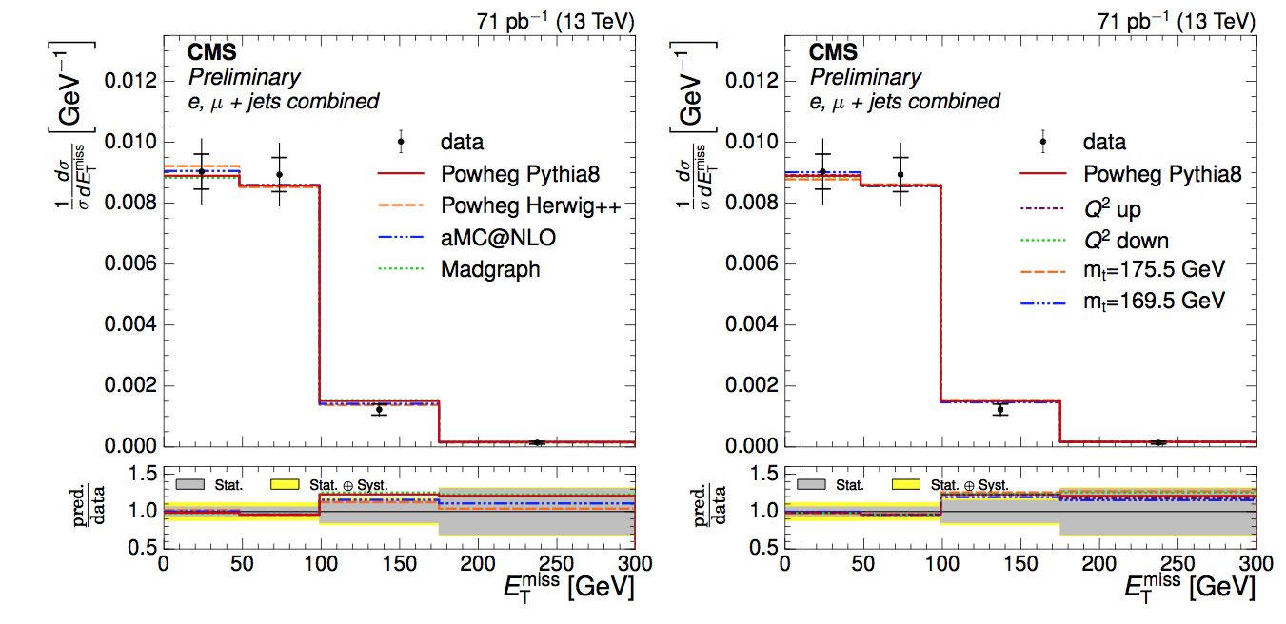

Differential distributions
With 71pb⁻¹ at 13TeV, in the l+jets channel
The distributions of E_{T}^{miss}, H_{T}, S_{T}, p^{W}_{T}, jet multiplicity, lepton p_{T}, and lepton |η| are unfolded to particle level and compared to predictions from different event generators and MC tunes
Main systematic uncertainties: modeling of the hadronization, choice of NLO generator, QCD background estimation
CMS-PAS-TOP-15-013
M
MET distribution: bridge from top to ttH, H→invisible, and to
tt+SUSY
See for example:
arXiv:1408.0011

Slide 32
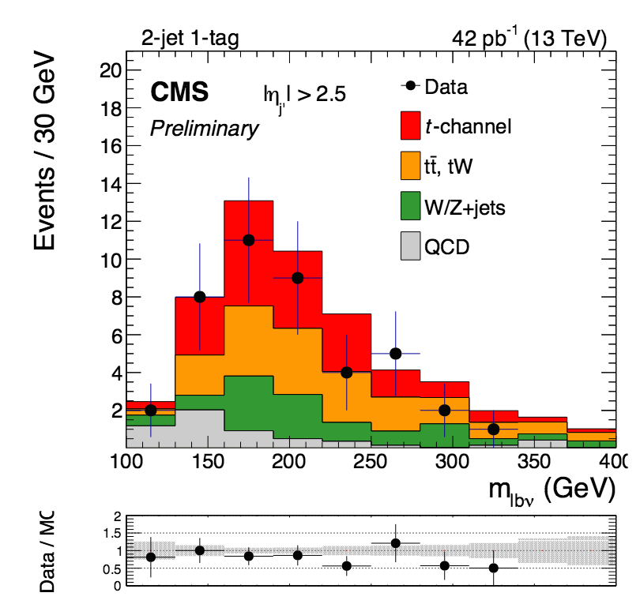
Single top at 13TeV
Already with 42pb⁻¹ → single top cross section is measured in the t-channel
µ only
Follows Run-1 strategies
cross section from a fit on the pseudorapidity of the light-quark jet that comes from the hard scattering process -often forward-, |η_{j’}|
Statistically limited
Main systematic: JES
Observed significance: 3.5σ
σ_{t-channel} =274±98(stat.)±52(syst.)±33(lumi.) pb
Once a rare top production mode that was also observed for the first time here (2009), the single top production is already a SM candle

Slide 33
Top AND Higgs physics at the LHC today
Looking at the future

Slide 34


Top - Higgs coupling
The top-Higgs coupling is very strong in the SM, and because the top is heavier than the Higgs → it cannot be assessed by measuring Higgs decays to top quark pairs
Can be experimentally constrained in gluon fusion production → happens via a fermion loop, top provides the dominant contribution -assuming no new physics are contributing to the loop
H→γγ has a fermion loop diagram dominated by the top-quark contribution
Within uncertainties, current measurements are so far consistent with the SM expectations
Probing the top-Higgs Yukawa coupling directly requires a process that results in both a Higgs boson and top quarks explicitly reconstructed via their final-state decay products

Slide 35


Production: ttH
Higgs produced in association with a top pair
It does not happen often:
It is the sixth process in terms of production cross section at the LHC (with a slightly lower rate than bbH) → 0.5pb at 13TeV
[though grows fast with √s → 0.13pb at 8TeV]
But when it does, it is flashy:
Final states with a Higgs decay and two
tops → HWWbb
With Run-1 data, we have studied this
production in all possible channels
H→bb
H → γγ
H→WW
H→ZZ
H → ττ
Direct bridge from top physics: tt+V processes
Submitted to JHEP
arXiv:1510.01131
JHEP 09 (2014) 087
arXiv:1408.1682

Slide 36



Production: ttH
All channels are statistically limited, no statement can be said regarding ttH production with Run-1 data, but limits are set
All the channels studied are combined and the best-fit value for the signal strength is 2.8 → excess above background-only of 3.4 standard deviations (2σ upward deviation with respect to the SM prediction)

Slide 37


Production: tHq
However, the only process in which top and Higgs are produced together that is sensitive to the sign of the top Higgs coupling is
tHq production
tHq is highly suppressed in the SM (0.018 pb @8TeV)
However, its production rate could be affected by anomalous top-Higgs couplings
In particular, a negative value of the coupling would increase the tHq cross section x15

Slide 38

Production: tHq
tHq production has very characteristic signatures:
A Higgs decay, a top decay (b-tagging), and a forward light jet (single top t-channel handle)
In CMS we have also studied it using Run-1 data, in almost as many channels as ttH:
H→bb*
H → γγ *
H→WW*
H → ττ
* Each of these had its own independent PAS
Submitted to JHEP
arXiv:1509.08159

Slide 39

Production: tHq
The sensitivity to a SM tHq will not be reached until well into Run-2 (or 3)
But sensitivity to a negative coupling will arrive much earlier

Slide 40
Production: tHq
A large rate of single top quark plus Higgs boson events could mean:
New physics showing up as Higgs boson mediated flavor changing neutral currents
Direct production of heavy new particles as predicted in composite and little Higgs models
8TeV: Vector-like T quarks decaying to top quarks and Higgs bosons (T→tH) [arXiv:1503.01952]
Moreover:
The exclusion of κ_{F}<0 is made under the assumption that no new particles contribute to the ggH and H→γγ loops, and that there are no BSM decays
tHq: Sensitive to the size and sign of the top-Higgs coupling, and relative sign between the couplings of vector bosons and fermions to the Higgs + BSM smoking gun

Slide 41

Decay: t→Hq
t→Hq
Flavor-changing neutral current Higgs (FCNH) → SM BR < O(10⁻¹³)
Extensions of the SM predict a larger branching fraction:
two-Higgs-doublet model, R-parity violating MSSM models, warped extra dimensions
8TeV analysis exploring tt→WbHq→lnubbbq
Full reconstruction of the top quark mass m_{Hj} or m_{bW} using MV techniques
NN are used to extract the signal (separated in t→cH and t→uH)
No excess of events over the SM background observed
B(t → cH) > 1.16% and B(t → uH) > 1.92% excluded at 95% CL
CMS-PAS-TOP-14-020

Slide 42


Charged Higgs searches
The Higgs sector of the minimal supersymmetric standard model (MSSM) consists of two Higgs doublets→ five physical states:
Light/heavy CP-even h/H, CP-odd A, and two charged Higgs bosons H±
For a low mass charged Higgs, t→H⁺b, for tanβ < 1 in some scenarios, H⁺→cs
tt→bH⁺bW, W→lν, using Run-1 data
Upper limits on B(t→H⁺b) assuming B (H⁺→cs) =100%
95% CL upper limits in the range 1.2–6.5% for a charged Higgs boson mass between 90 and 160 GeV
Submitted to J. High Energy Phys
arXiv:1510.04252

Slide 43
Ramping up
The number of top+Higgs results in CMS is increasing with time -and center of mass energy:
ttH:
8TeV: H→bb using ME [arXiv:1502.02485]
7TeV + 5fb-1 of 8TeV: H→bb [arXiv:1303.0763]
FCNC decays:
8TeV: t→Hq, H → γγ [PAS-TOP-14-019]
8TeV: t→Hq, H → WW/ZZ/ττ [PAS-TOP-13-017]
Charged Higgs:
8TeV: Light and heavy charged Higgs in tt decay and produced together with a top, decaying either via H⁺→τν or H⁺→tb [arXiv:1508.07774]
7TeV: Light charged Higgs in tt decays: t→H⁺b, H⁺→τν -tanβ >5 [arXiv:1205.5736]

Slide 44
What’s next?
Run-2 → we have 3 years ahead, and > 100fb⁻¹ to look forward to
With the new data:
We will scrutinize the top sector in search for new phenomena
Rare top decays
Heavy resonances decaying to top
New particles produced with top
Top partners…
The Higgs will be fully characterized
Precision measurements of properties
And many exotic Higgs scenarios studied
SM and BSM channels with top and Higgs produced together will be explored
Sensitivity to observe ttH production will be achieved
top-Higgs Yukawa coupling measured
Exotic searches with top and Higgs will become more relevant

Slide 45
Summary
The Higgs boson and the Top quark could have a role in the search for new physics during Run-2 and beyond → also Top and Higgs together
We are entering in a precision era for Higgs
New physics could be hiding in deviations with respect to the SM
So far, everything consistent with the predictions
The LHC continues being very powerful for top physics
Unprecedented precision in Run-1
With the first Run-2 data tt and single top t-channel were already studied
Signatures with top and Higgs could be key to future discoveries
First analyses in place during Run-1, will only be sensitive with Run-2 data

